Slide 1

No Servers? No Problem! Demystifying Azure Functions
2025

Slide 2
Agenda
What?
Why?
How?

Slide 3
Default (in-process) vs Isolated Worker
Feature | Default (in-process) | Isolated Worker
Runtime | Function code runs in same process as Azure Functions host | Functions run in own, isolated process
Flexibility | Limited No Program.cs/Startup.cs Only installed.NET versions | Full control over DI, Middleware, … through Program.cs .NET Version
Performance | Quick coldstart, but limited by shared resources | Slower coldstart, but more performant in the long run
Support | Support ends 10/11/2026 | Supported

Slide 4

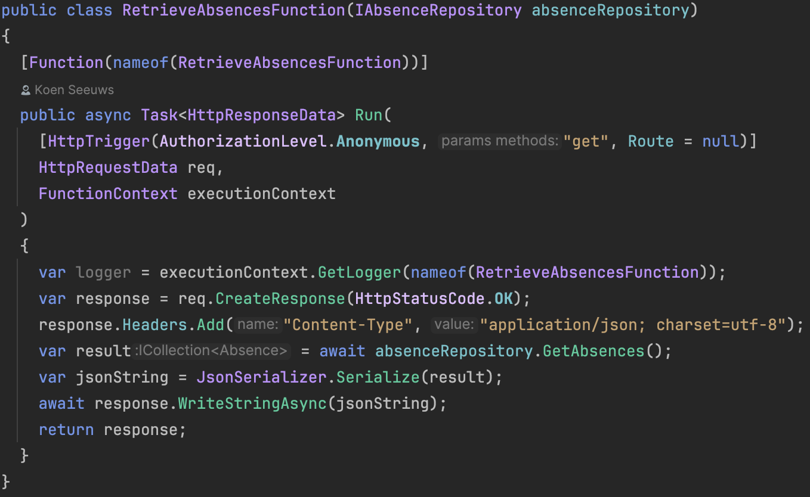
Triggers
Notes:
Trigger nodig om functions te runnen:
Timer based
Http Based
Queue message
SignalR
CosmosDB
...

Slide 5
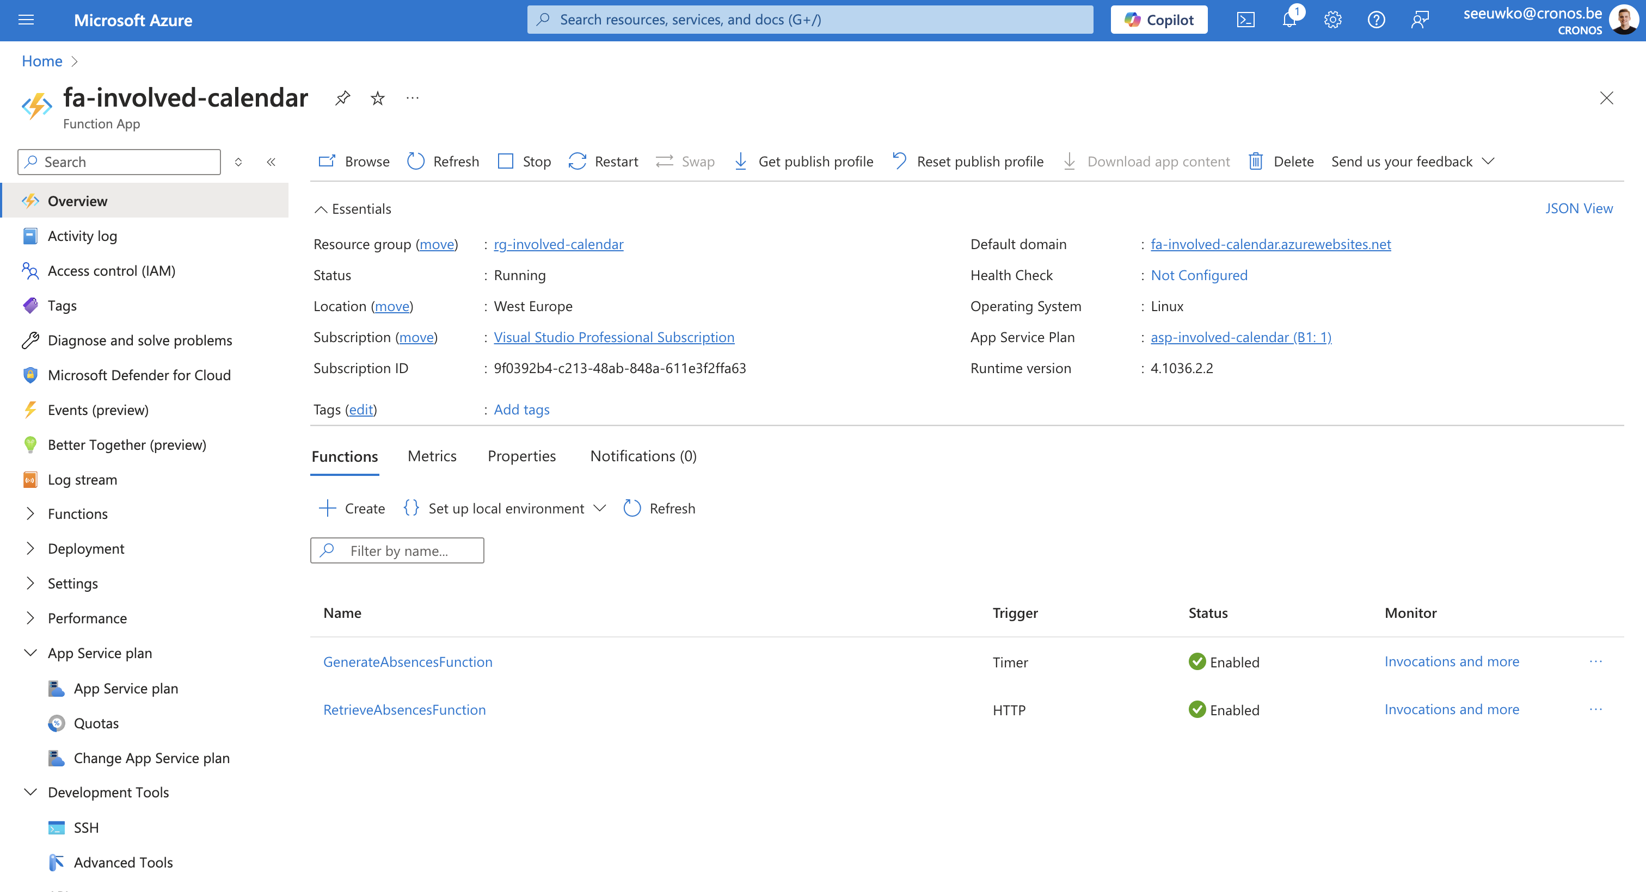
How does this look in Azure?

Slide 6




@involved_it
Veldkant 35C, 2550 Kontich

